Slide 1

IGN ITE Proposal
By: Tashundre Gilmore
StarByte Technolgies

Slide 2

Client Goals & Objectives
The IGN Center’s new Information Technology Education (ITE) Department, located in Gainesville, Florida, has submitted a Request for Proposal (RFP) for the design, planning, and installation of a modern IT infrastructure. StarByte Tech has been selected to propose a comprehensive networking solution to meet their educational and operational needs.

Slide 3

Project Scope Includes:
Provide wired (Gigabit Ethernet) and wireless (high-speed) connectivity
Integrate existing servers (FTP & 4 NetLab servers) into new network
Ensure physical security, cooling, and power protection
Plan for future scalability and network redundancy
Offer optional maintenance & support services
Deliverables:
Complete network design with diagrams
Hardware and installation materials list with prices
Cloud storage recommendations
Labor cost estimate covering planning to deployment
ThePhoto by PhotoAuthor is licensed under CCYYSA.

Slide 4
Physical & Logical Network Design
Key Areas in the Network:
Server Room
Houses existing FTP server and 4 NetLab servers
Includes rack-mounted switches, cooling units, UPS
Classrooms (x10)
Equipped with desktop PCs connected via Ethernet
Ceiling-mounted Wireless Access Points (WAPs) for mobile devices
Faculty Offices (x9)
Wired & wireless access
VOIP phones and printer in breakroom
Main Switches & Patch Panels
Located in server room for centralized control
Connected to all end devices through structured cabling
🔄 Server Integration
FTP Server: Integrated into the network via a dedicated VLAN for secure file access and course materials
NetLab Servers (x4): Assigned to their own VLAN with firewall rules and port forwarding to support remote labs and sandboxing
📶 Wireless Design
WAPs in each classroom and hallway
Coverage overlaps to avoid dead zones
Supports dual-band (2.4GHz & 5GHz) for fast, reliable access.

Slide 5
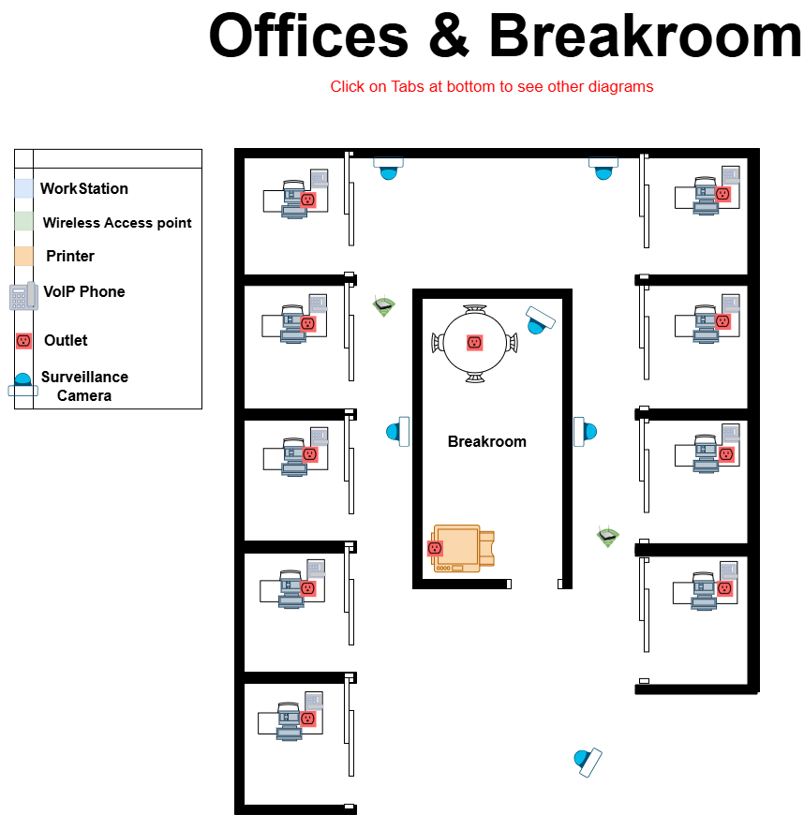
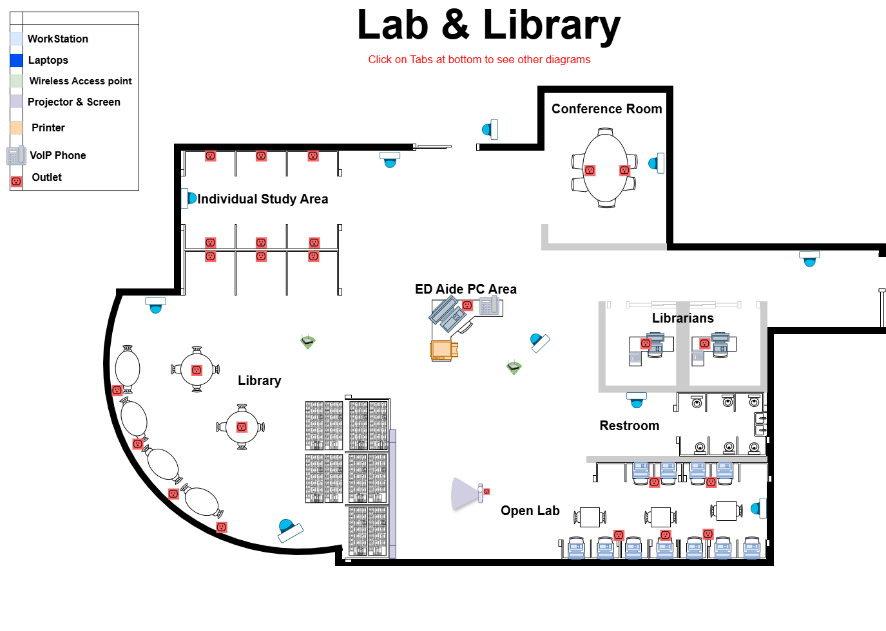
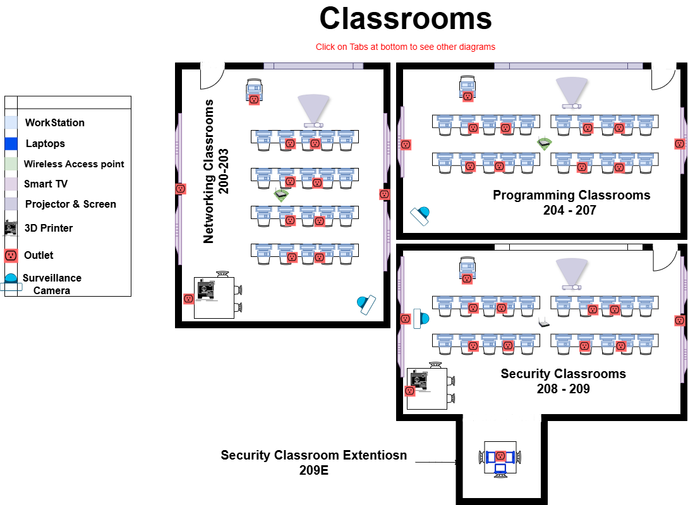
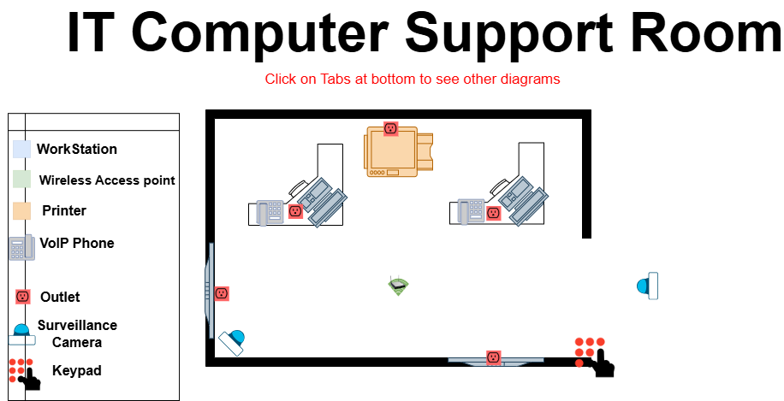
Classroom Layouts (Rooms 200–209 + 209E):
Each classroom includes:
Student workstations (wired via Ethernet)
Dual monitors
Teacher station with a VoIP phone
Wireless Access Point (WAP)
Smart TV and Projector setup
Security classrooms feature additional endpoints and a 3D printer.
Library & Open Lab Area:
Hosts 11 open lab PCs, a teaching assistant station, and a printer
Fully equipped with WAPs, VoIP, and accessible power outlets
Designed for collaboration, study, and independent research
Faculty Offices & Breakroom:
Each office includes:
A wired workstation
VoIP phone
Printer access
Breakroom includes a camera for monitoring and an outlet setup
IT Computer Support Room:
Equipped with:
2 workstations
A shared printer
WAP, VoIP, and surveillance camera
Central point for internal support and troubleshooting
Connectivity & Cabling:
Structured cabling runs from the server room’s main rack to all networked rooms
Cable paths are planned for efficiency, minimal disruption, and ease of maintenance
Outlets and WAPs are clearly placed for accessibility and coverage
Security Devices:
Surveillance cameras installed in strategic areas including the IT room, breakroom, and open lab
A keypad for controlled server room access ensures physical security compliance

Slide 6
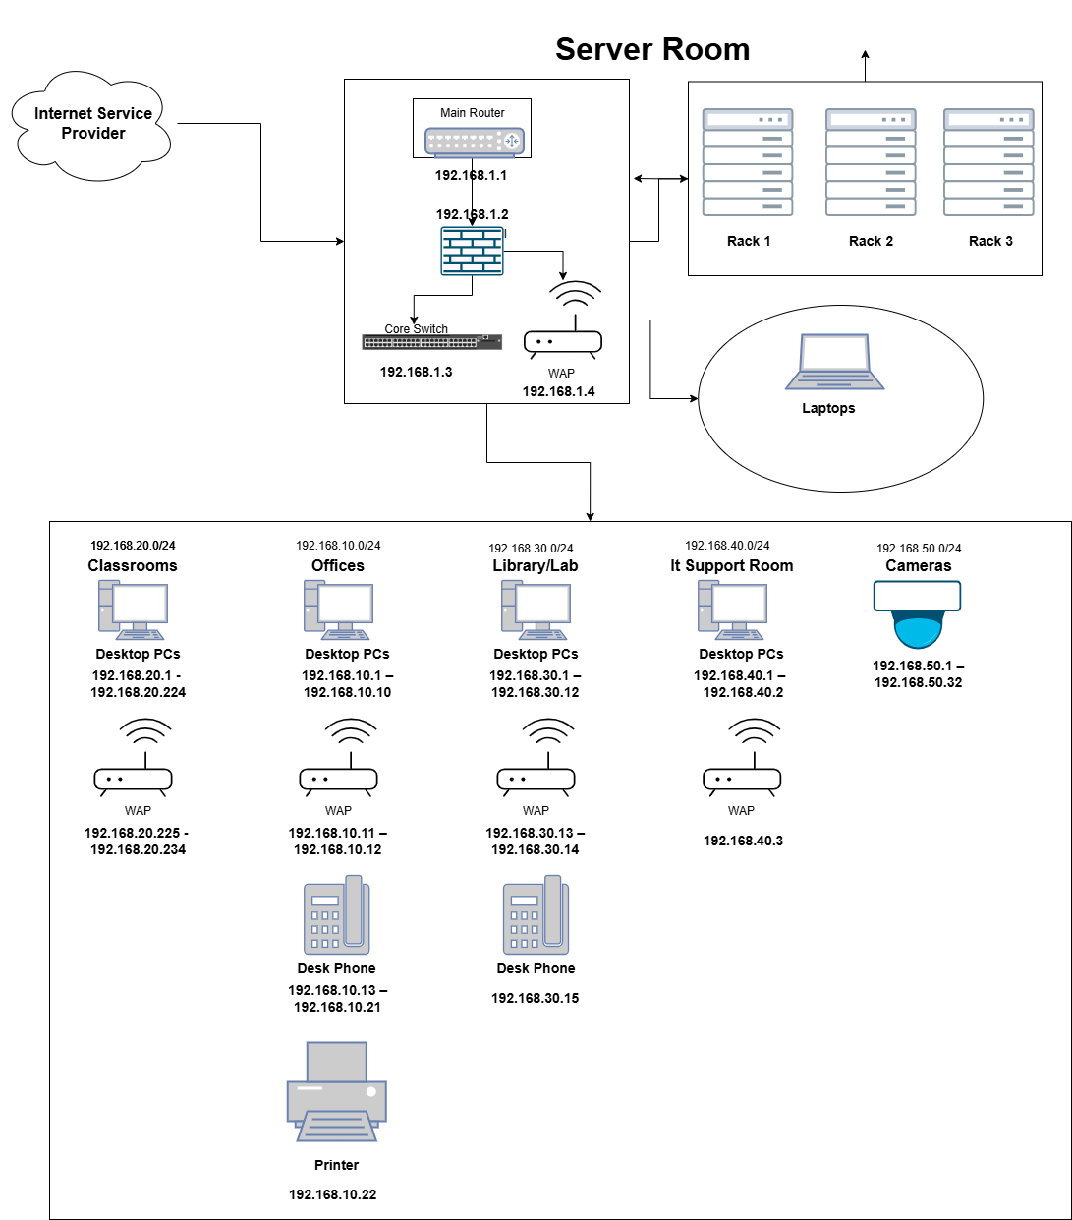
The logical network design for the IGN Center ITE Department illustrates a segmented, high-performance architecture that supports secure communication and efficient traffic flow across the facility.
Core Components:
ISP → Firewall → Main Router → Core Switch: This central flow forms the backbone of the network, ensuring secure and managed access to the internet and internal resources.
Subnet Breakdown (with VLAN-style segmentation):
192.168.10.0/24 – Offices & Admin Area Includes desktop PCs, VoIP phones, and a shared printer
192.168.20.0/24 – Classrooms Houses student desktops and laptops, supported by dedicated WAPs
192.168.30.0/24 – Library/Lab Area Covers open lab PCs, a teaching assistant device, and support room endpoints
192.168.40.0/24 – IT Support Room Contains support workstations and equipment
192.168.50.0/24 – Security Devices Dedicated subnet for IP cameras and future surveillance devices
Wireless Access Points (WAPs):
Distributed across all functional areas, each assigned to appropriate subnets for wireless connectivity to laptops and mobile devices.
Server Room:
Connected directly to the core switch, the server room houses 3 racks for FTP, NetLab servers, and future equipment, reinforcing centralized resource management.

Slide 7
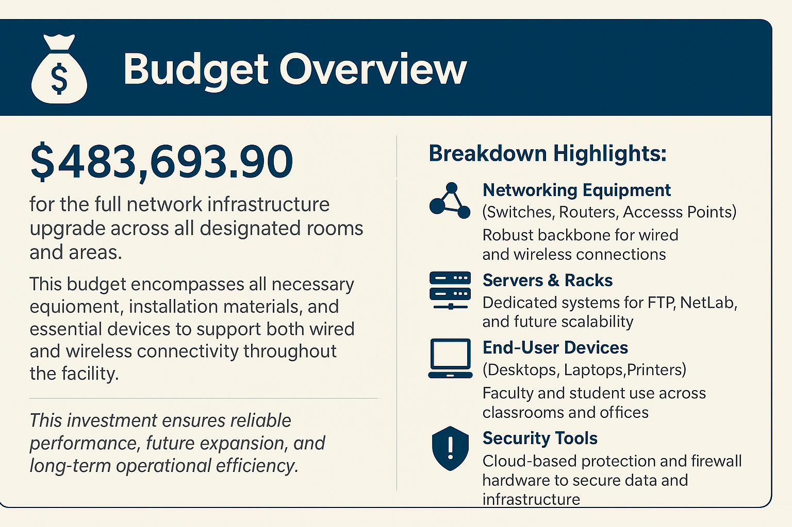

Slide 8
Project Timeline Estimated project duration: 8-10 weeks
Phase | Duration
Planning & Assessment | 1 Week
Design Finalization | 1 Week
Procurement & Delivery | 1–2 Weeks
Installation | 2 Weeks
Testing & Optimization | 1 Week
Training & Handover | 1 Week
While the project can be completed within 6–8 weeks under ideal conditions, we recommend a 10-week timeline to account for potential delays in equipment procurement, site preparation, and training feedback loops. This ensures the project remains on track without compromising quality.

Slide 9

Why Choose StarByte Technologies?
At Starbyte Technologies, we don’t just install hardware — we architect galaxies of connection. Intuitive, secure, and built to grow with you. Our team approaches technology like a craft: structured with care, scalable with intention, and sprinkled with a little spark of brilliance.
This proposal isn't just a checklist of devices — it's a thoughtful blueprint for long-term success.
We listened deeply to the needs of the IGN Center’s ITE Department — and we translated those needs into a design that balances performance, security, and ease of use.
We mapped out everything from high-speed wired access to seamless wireless roaming, ensuring students and staff have a stable experience no matter where they are.
We future-proofed the layout with scalability, so expansion won’t mean a full redesign.
Our diagrams, documentation, and budget show not just what we’ll do — but how and why we’ll do it.
More importantly: we care. We’re not here to overcomplicate things or push flash without function. We're here to build a network that just works — quietly, powerfully, and with the grace of a well-tuned constellation.
Choose Starbyte Technologies — Where every connection is cosmic, every detail is intentional, and your network is built to last — with just a hint of stardust.

Slide 10
Questions?
Thank you for taking this journey through the stars of infrastructure with us. We hope our solution lights the path toward a more connected, secure, and scalable future.
Presented by: Tashundre Gilmore Company: Starbyte Technologies Email: [gilmoret@starbyte.org]

